Slide 1
Is it a moth?
Teetly (Sanjana Yasna)

Slide 2
Diagram of overall fine-tuning pipeline

Slide 3
Major Limitations of this Project:

Slide 4
EfficientNet Datasets

Slide 5
EfficientNet end-of-fine-tuning evaluation metrics: (positive is non-moth)
Dataset | Accuracy | Precision | Recall | True Positive Rate | False Positive Rate
Limited | 94.1% | 0.92 | 0.97 | 0.97 | 0.92
Full | 96.4% | 0.95 | 0.98 | 0.98 | 0.95

Slide 6
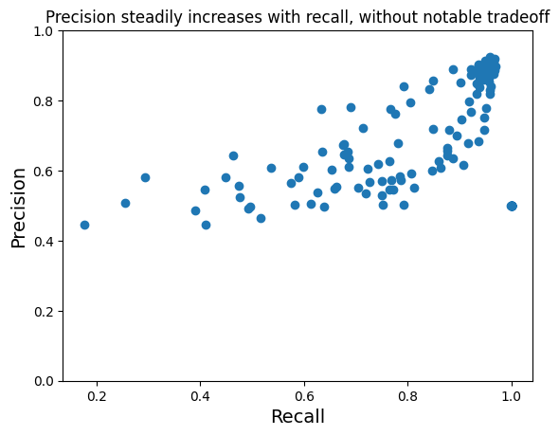
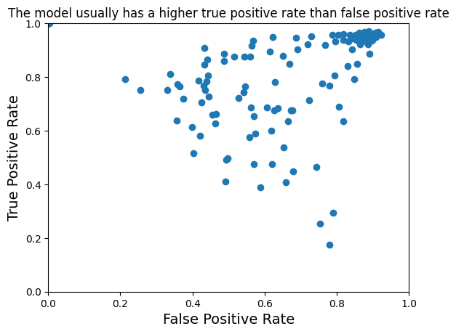
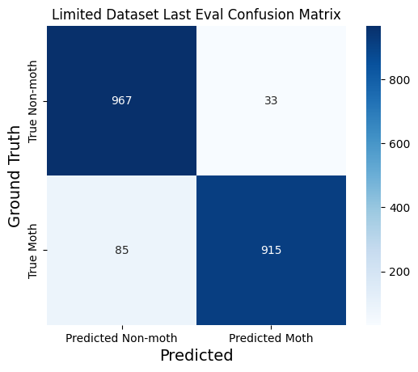
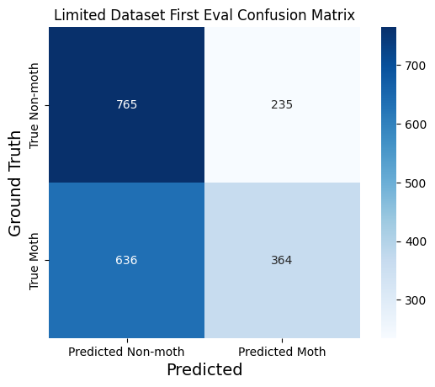
Limited Dataset:

Slide 7
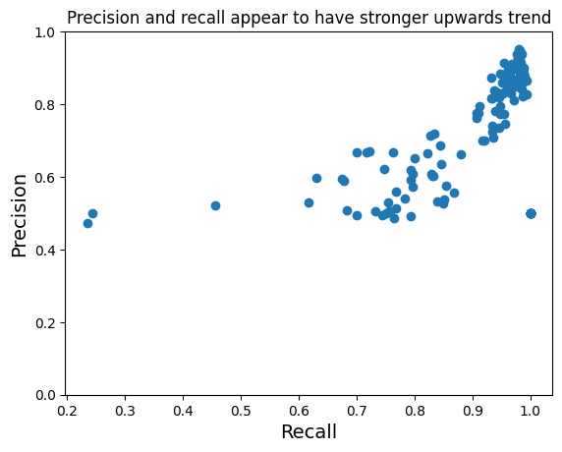
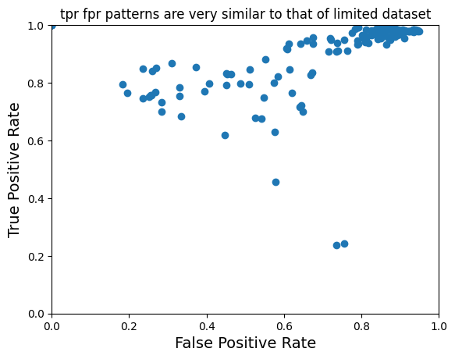
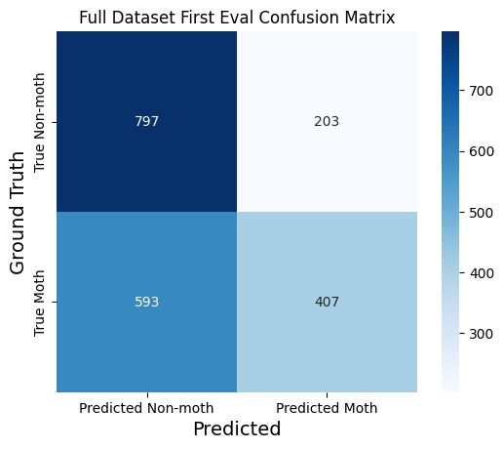
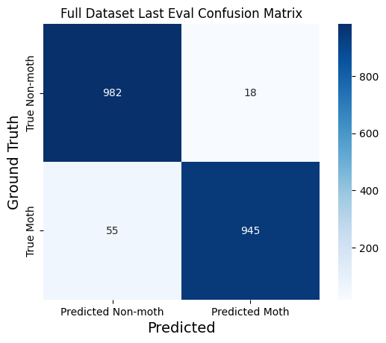
Full Dataset

Slide 8
Diagram of efficientnet coupled with GroundingDino

Slide 9


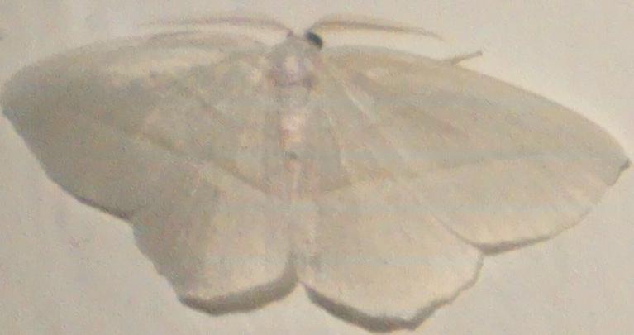
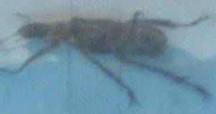
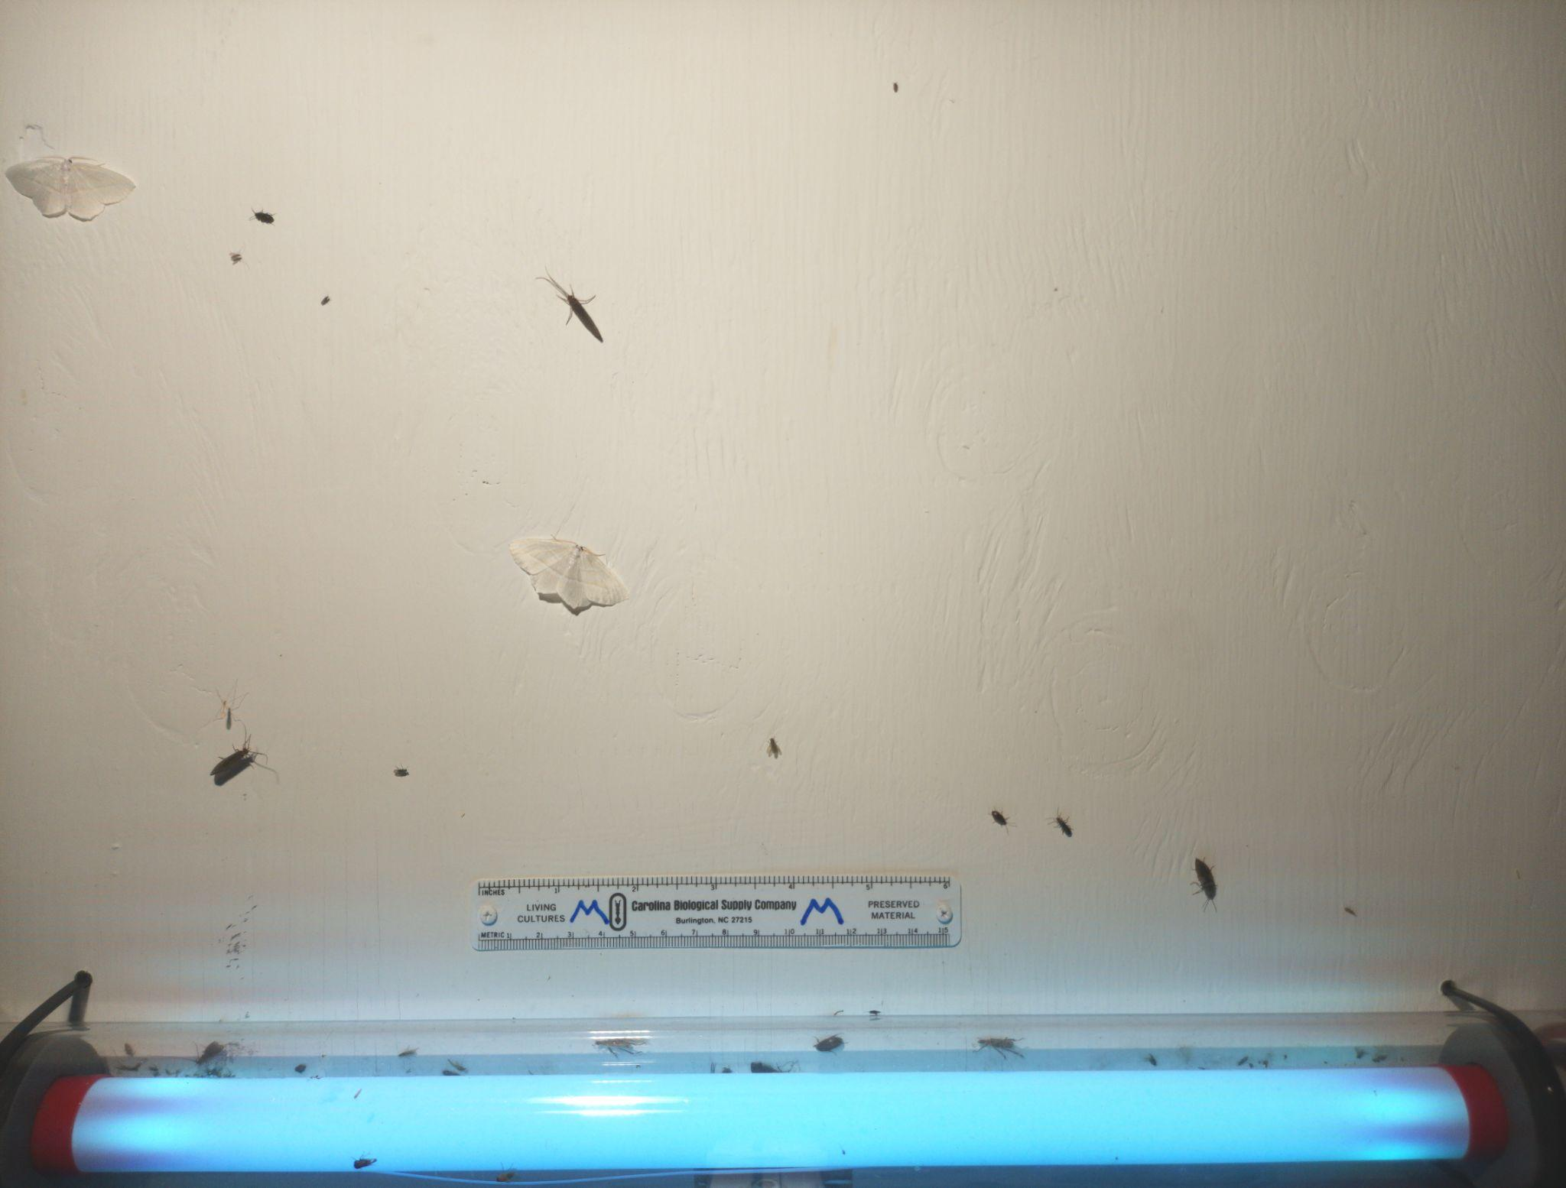
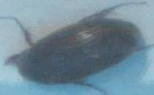
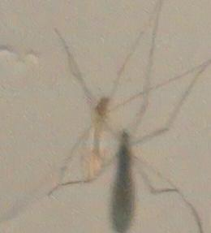
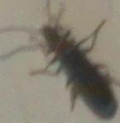
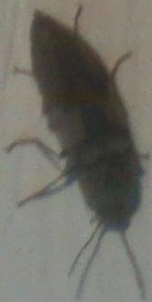


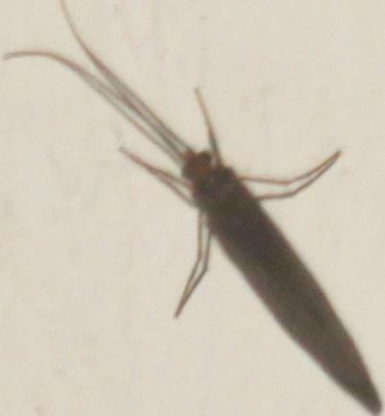
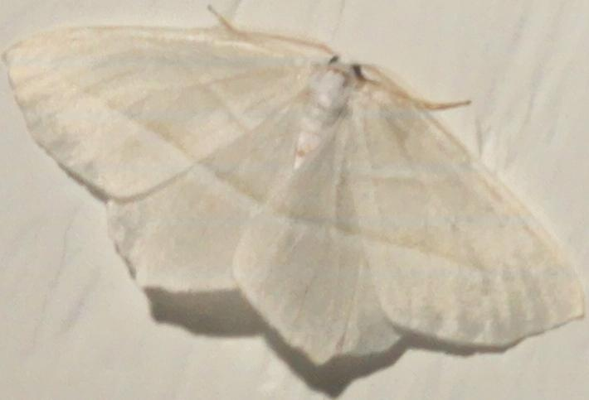
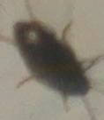

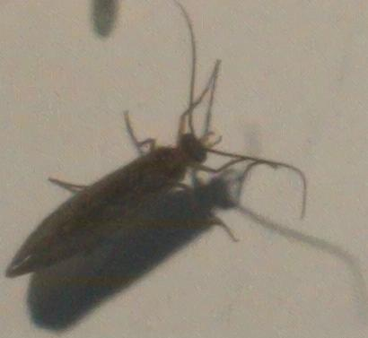

Example crops from groundingDino
(not representative of actual image size)
main/mothitor_yolo/ama_2024-06-17_23_00_04.jpg

Slide 10
Resulting labels from efficientnet (top1)
(not representative of actual image size)
moth
non-moth
Notes:
Note: lighting is a major issue–model not exposed to images with insects under bluish light…so it categorizes these insects as moths

Slide 11
Resulting labels from efficientnet (pass@5, cutoff 0.9999)
(not representative of actual image size)
moth
non-moth
Notes:
Additional demos: car_2024-07-31_23_00_03.jpg (2 obvious moths)
Car_2024-08-05_22_30_03.jpg (a few different things that look like moths)

Slide 12
Fine-tuned efficientnet cannot generalize to the Mothitor dataset :((

